Slide 1
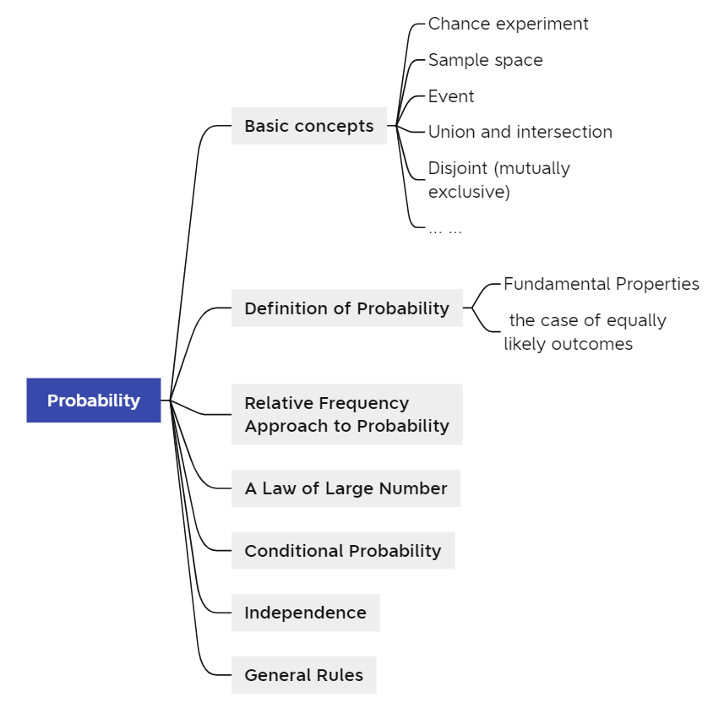

Slide 2
Probability
Lecture 1
Notes:
我们开始学习新的一章，概率，Probability。
我们生活中其实就经常接触概率

Slide 3
Impossible
Unlikely
Equally likely as not
Likely
Certain
You will get a head or a tail.
You will get a tail.
The coin will turn into a bottle of ketchup.
The coin will land somewhere.
The coin will land on its edge.
Notes:
比如：我提醒我们班的同学要升旗，然后他和我说，老师，我尽量升旗不迟到，他都没有说保证，那就说明他对自己有一定的判断，他很可能早上起不来，能来升旗的概率很小。
包括对于impossible, unlikely等等这些词我们也经常接触，比如对于抛硬币的问题，大家来把发生以下五个事情的概率和这几个词对应一下。
Impossible: The coin will turn into a bottle of ketchup.
Unlikely: The coin will land on its edge.
Equally likely as not: You will get a tail.
Likely: You will get a head or a tail.
Certain: The coin will land somewhere.
我们对于概率是一直有概念的，只不过没有正式的定义和计算罢了
那我们来看一些基础概念

Slide 4
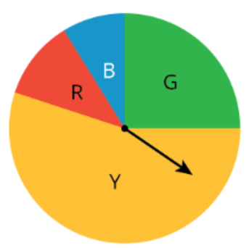
Basic Concept
Chance experiment:
There is uncertainty about which of two or more possible outcomes will result.
For example, each time you spin the
spinner, it could land on red, yellow,
blue, or green.
When a single coin (a fair coin) is
flipped, do we know in advance what the
result of a particular roll will be?
Notes:
Chance Experiment：你永远不知道这个事情的确切的结果是什么，比如

Slide 5
Basic Concept
When a single coin (a fair coin) is flipped, how many possible outcomes are there?
    Two possible outcomes: Heads and Tails.
Outcome
An outcome of a chance experiment is one of the things that can happen when you do the experiment.
Notes:
抛硬币也是一个chance experiment， （忽略硬币立起来的情况）我们掷一次硬币，会有几种可能性？
两种可能性。
但是我们没有办法预测下一次我投硬币，结果是Heads还是Tails。
这里面的Heads 和 Tails我们叫做 outcomes

Slide 6
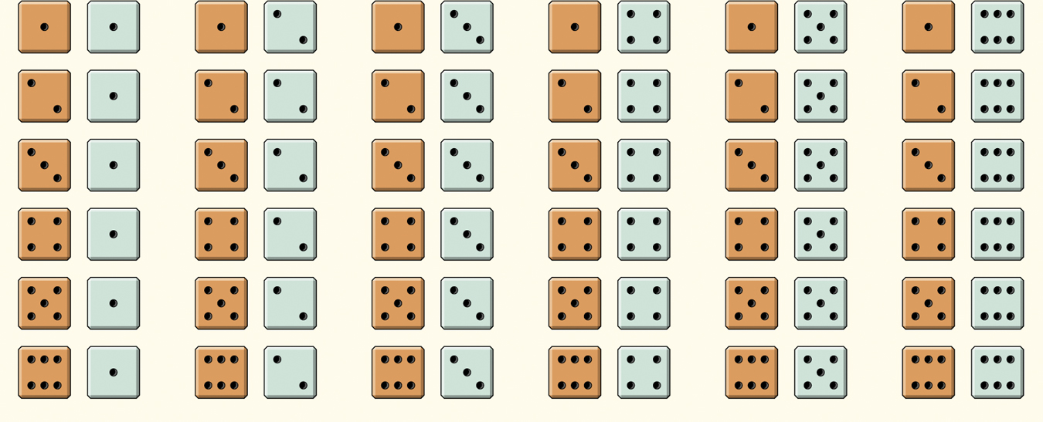
Basic Concept
Consider rolling both a red die and a green die.
How many possible outcomes in all?
36 possible outcomes
Since the dice are fair, each outcome is equally likely.
Each outcome has a probability of 1/36.
Notes:
那大家来练习一下，如果我现在掷两个色子，一个是红的一个是绿的，一共有多少个outcomes？
(1,1),(1,2),…,(1,6)
(2,1),…(2,6)
…

Slide 7
Basic Concept
Sample space: “set”, “a collection of elements”
  A set of all possible outcomes of an experiment.
Outcome: “element”
Event: “set”
    An event is a collection of outcomes from the sample space of a chance experiment.
Notes:
这36个outcomes构成的集合，叫做sample space。
以outcomes作为集合中的元素，包含所有outcomes的一个集合，一个全集。
Sample space： A set of all possible outcomes of an experiments.
Event：事件，是一个集合，元素也是outcomes，是sample space的一个子集
比如，我的红色和绿色的两个筛子，我红色的筛子掷到偶数点的事件怎么表示？
{(2,i),(4,i),(6,i)},i=1,2,3,4,5,6
一般用大写字母表示

Slide 8
Practice:
Rolling a six-sided die (fair dice with 6 faces) Outcomes ?
Sample space ?
Event that the number of face is even ?

Slide 9
Rolling a six-sided die (fair dice with 6 faces)
Outcomes:
1,2,…,6
Sample space :
{1,2,3,4,5,6}
Event that the number of face is even :
{2,4,6}

Slide 10
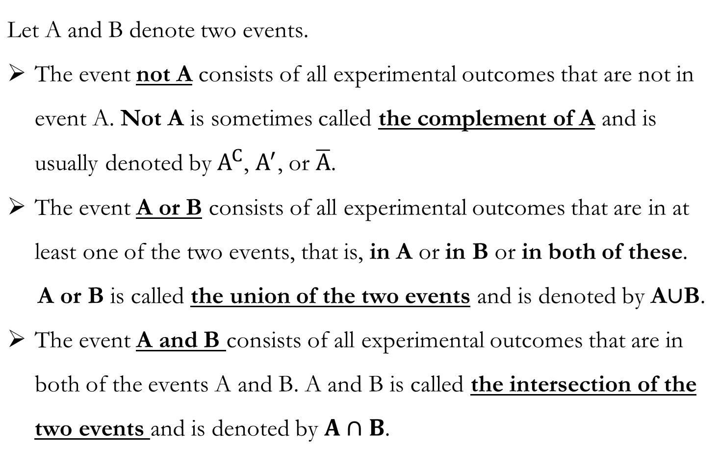
Basic Concept: Complement, Union, Intersection
Notes:
补集：
那我掷色子，A={2,4,6},A’=?
A={2,4,6}, B={1,2,3}
合集: A发生了或者B发生了。
A or B = {1,2,3,4,6}
交集: A和B同时发生。
A and B = {2}

Slide 11
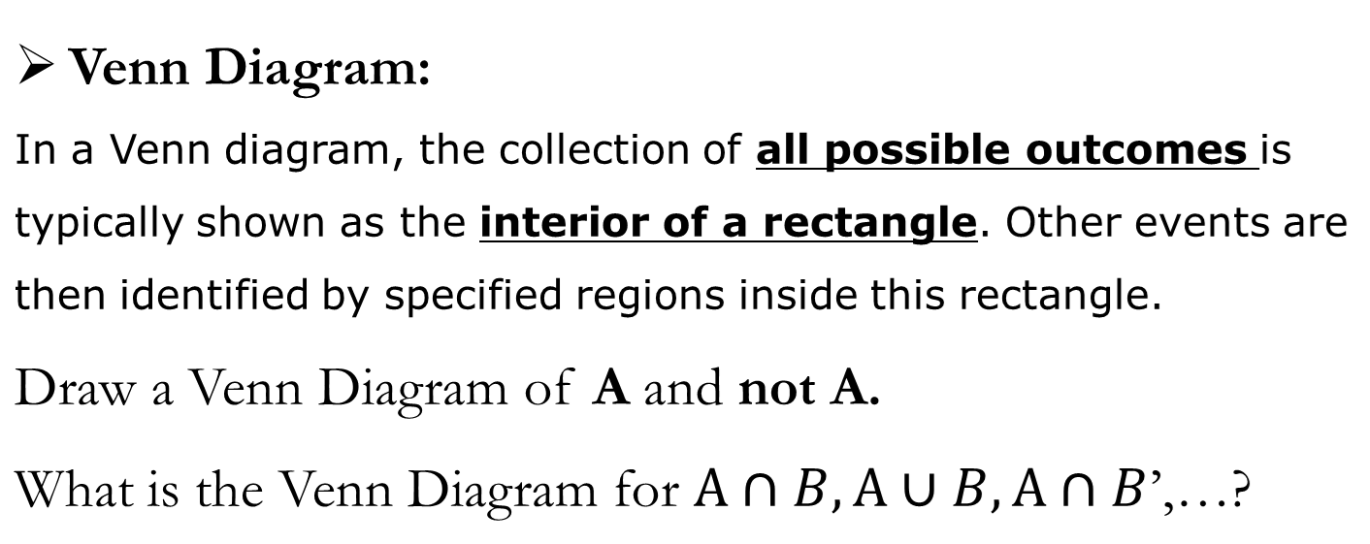
Basic Concept
U
U
A
A
Notes:
我们也可以用Venn Diagram来表示事件和事件之间的关系
在维恩图里，我们会画一个长方形表示全集，
面积也就代表着概率的大小

Slide 12
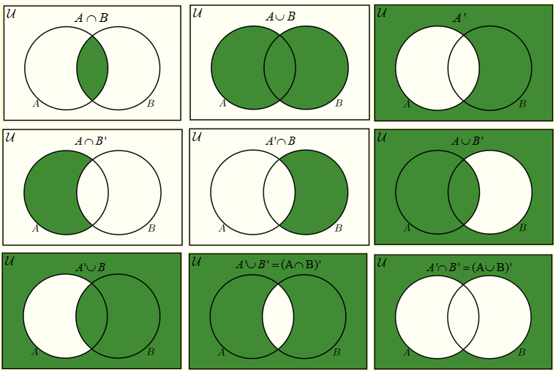
Notes:
A AND B’ = (A’ OR B)’

Slide 13
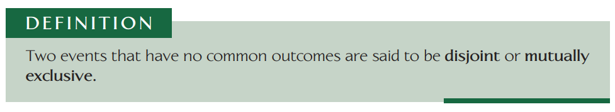
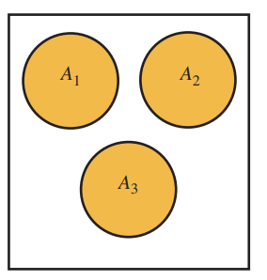
Basic Concept
Disjoint (mutually exclusive)
Notes:
Mutually exclusive 互斥事件，一件事发生了，另一件必定不会发生，比如掷色子，每个点数的关系就是互斥，我这次掷到1，这次就不可能是2

Slide 14
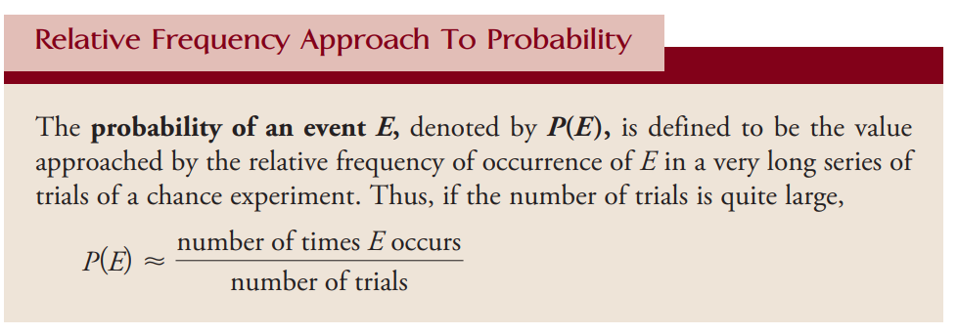
Probability
Probability is simply how likely something is to happen.
Notes:
我们来看一下prob的定义，描述的是how likely something is to happen
其中一种衡量概率的方法就是用relative Frequency频率去近似。
Lim (# of trails ->infinite) (relative fre) = prob

Slide 15

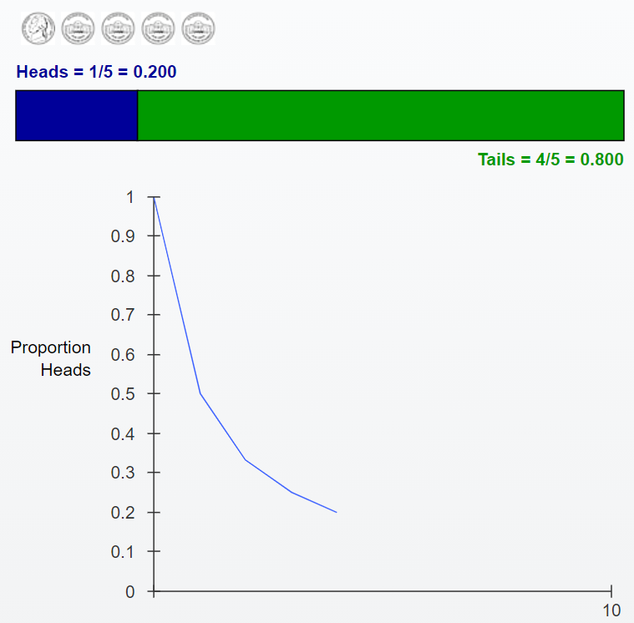
http://digfir-published.macmillanusa.com/stats_applet/stats_applet_10_prob.html
Notes:
我投了五次硬币，结果分别是HTTTT
得到了下面的图，纵坐标代表什么？
Heads出现的次数比上掷硬币的总次数，这个叫啥？
频率。
出现了一次H，那H对应的频数就是1，频率就是20%
那我们看随着掷硬币次数的增多，会出现什么情况？

Slide 16
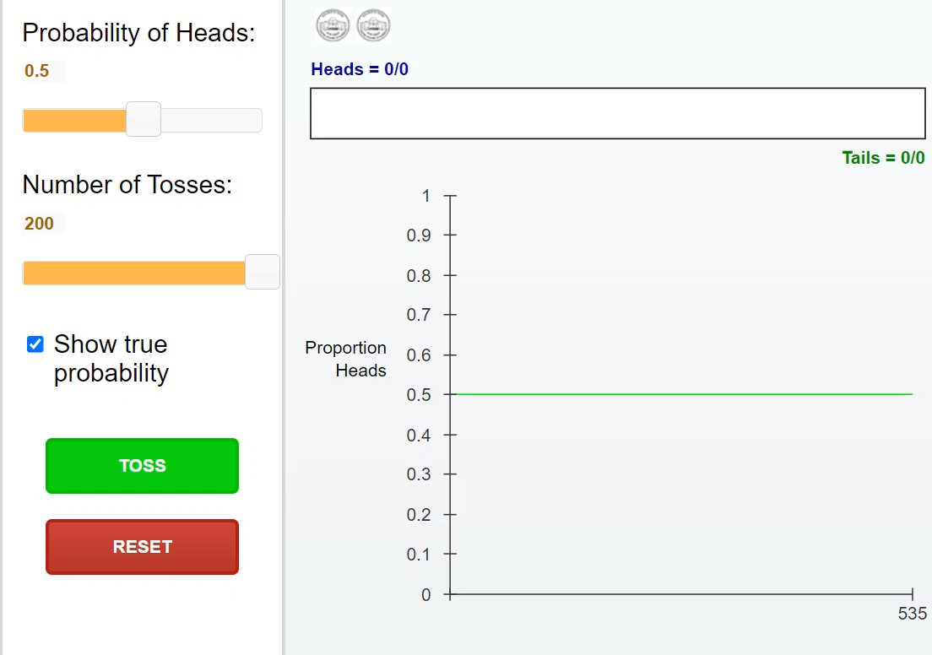
Notes:
频率趋向真实值0.5

Slide 17
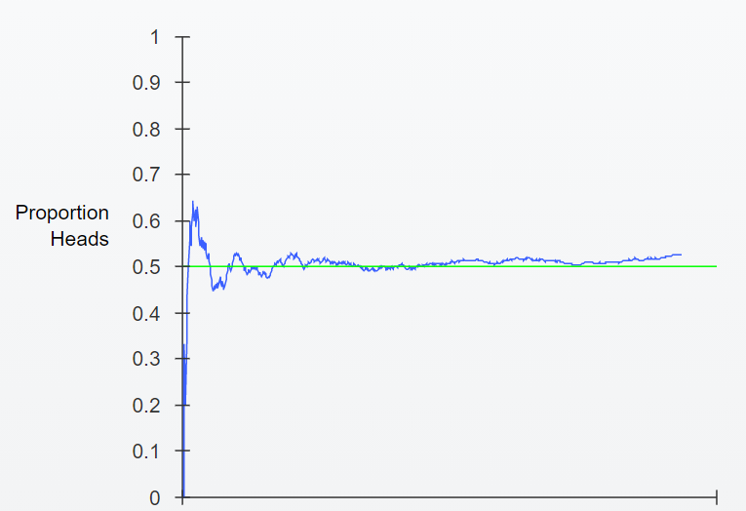






Slide 18
Simple definition of probability
In the dice-rolling example, suppose we define event A as “sum is 5”.
What is the value of P(A)?
There are 4 outcomes that result in a sum of 5.
Since each outcome has a probability of 1/36,
P(A) = 4/36=1/9.
Notes:
还有一种定义叫做simple def of prob
我们先来看一个例子

Slide 19

Simple definition of probability
In the dice-rolling example, suppose we define event A as “sum is 5”.
What is the value of P(A)?
  When all outcomes are equally likely.
Notes:
我们的分子是不是把所有可能性的outcomes都找出来了
分母就是sample space中outcomes的个数
所以当每个outcome概率都一样的时候，prob= 。。。

Slide 20
Define event B as “sum is not 5.” P(B)=?
P(B) = 1 – P(B’)
= 1 - 1/9
= 8/9

Slide 21
You have a fair coin. You flip it 10 times.
In which situation is getting tails (T) on your next flip more likely?
Situation 1: HTTHHTHTHT
Situation 2: HTTHHHHHHH
It’s equally likely!
The probability doesn’t change because of previous results.

Slide 22
Chance behavior is unpredictable in the short run, but has a regular and predictable pattern in the long run.
The law of large numbers says that if we observe more and more repetitions of any chance process, the proportion of times (relative frequency) that a specific outcome occurs approaches a single value (probability).
Law of large numbers:
After many trials, the relative frequency of outcomes will approach their probability.

Slide 23

Practice
There are 8 red marbles and 12 blue marbles
in a jar. What is the probability of selecting
a red marble from the jar?
R: Event of selecting a red marble from the jar
P(R): Probability of Event R occurring

Slide 24
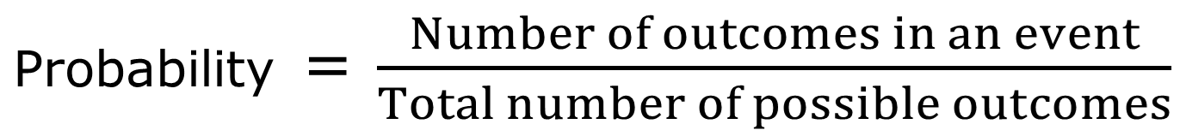

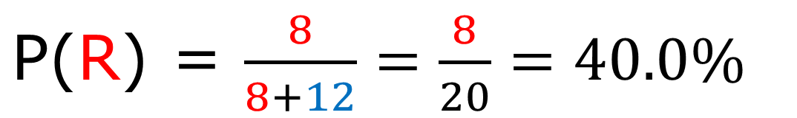

Slide 25
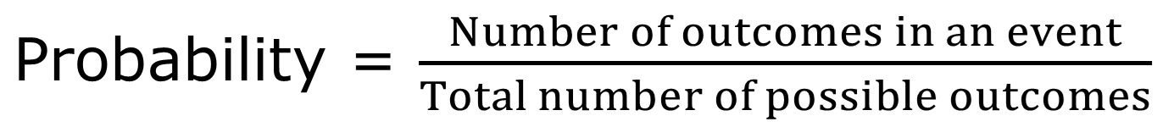
Properties
Probabilities are always between 0 – 1 (0% - 100%).
If S is the sample space for an experiment, P(S)= 1
Complement rule:
  the probability of event A not happening, P(A^{C}),
  is equal to 1 – P(A).

Slide 26
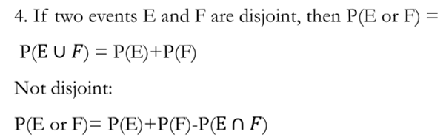
Properties of Probabilities

Slide 27
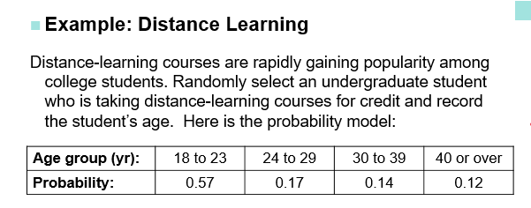
(a) Show that this is a legitimate probability model.
(b) Find the probability that the chosen student is not in the traditional college age group ( 18 to 23 years ).

Slide 28
Show that this is a legitimate probability model.
  each probability is between 0 and 1
  the sum of all probabilities is 1: 0.57+0.17+0.14+0.12=1

Slide 29
(b) Find the probability that the chosen student is not in the traditional college age group ( 18 to 23 years ).
P(not 18 t0 23 years old) = 1 – P(18 to 23 years old)
= 1-0.57
= 0.43

Slide 30
P326 6.3, 6.7
P341 6.25

